Slide 1

Springboard Foundations of Data Science Capstone Project
Predicting Airbnb listing price
Student: Shannon Dussoye Mentor: Raghunandan Patthar

Slide 2

What is Airbnb?
Airbnb is an online marketplace and hospitality service, enabling people to lease or rent short-term lodging including vacation
rentals, apartment rentals, homestays, hostel beds, or hotel rooms.

Slide 3
Some Numbers
Number of Airbnb listings: 2.3m
Average number of nightly stays: 500,000
Number of active Airbnb cities: 65,000
20% of guest lists their properties on Airbnb

Slide 4
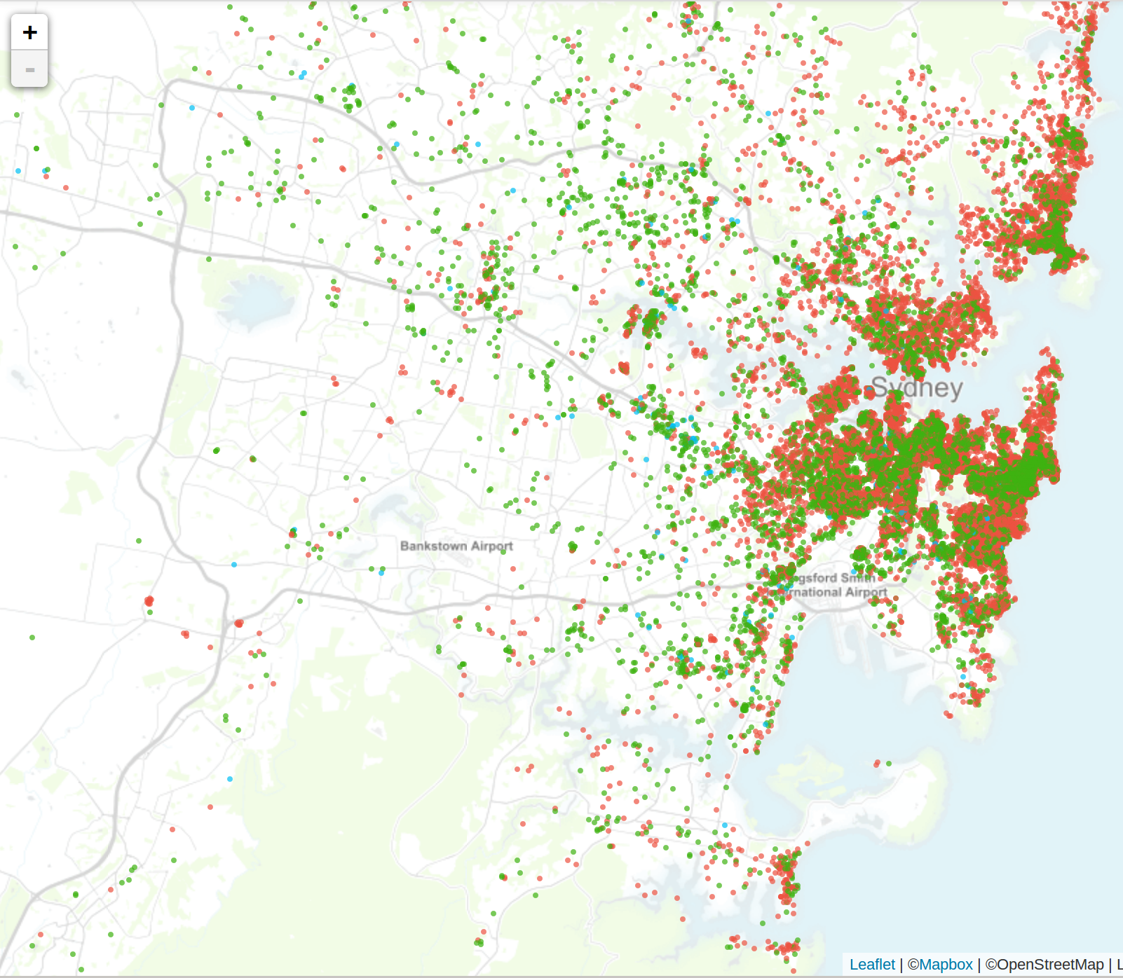
Motivation
There are 23,615 listings
in New South Wales
Australia.
Listing prices are added by owners and might not be competitive.
We’ll create a model that will predict the listing price based on a number of different attributes.

Slide 5
Approach
As Airbnb is mainly used for holiday rentals, we’ll use the following attributes to predict the price:
How far is the listing to the closest city
Weather a train station is within 1km of the listing
Number of Points of Interests within specific distance
How far is the listing to the beach

Slide 6
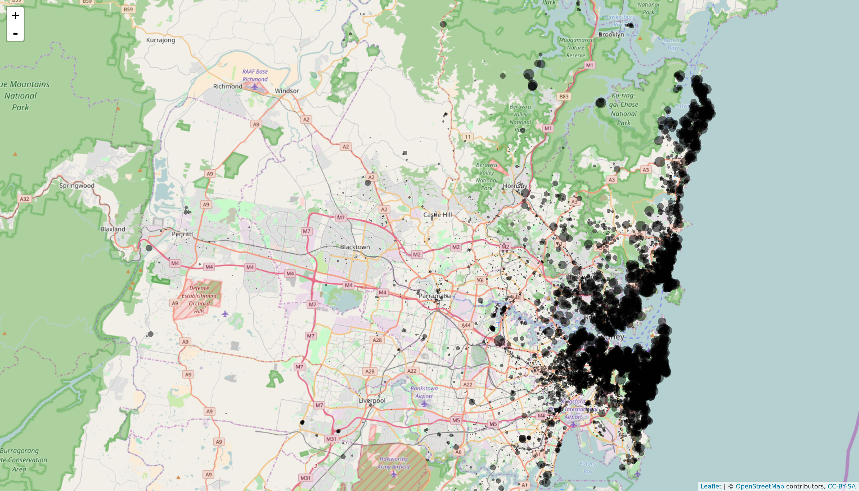
Listings Price
The map shows the listings in NSW and the size of the circles depicts the price.
As it can be seen the price is higher along the coast.
However, there as other areas where price is high.

Slide 7
Features Selection & Engineering
Feature Selection
The dataset contains around 95 attributes relating to the renter and listings specification. Only important features were selected and only 15 important attributes were selected.
Feature Engineering
Features relating to Points of Interests were created. e.g. whether the nearest city is within 1/5/10 km of the listing and number of POI within 1/5/10 km.

Slide 8
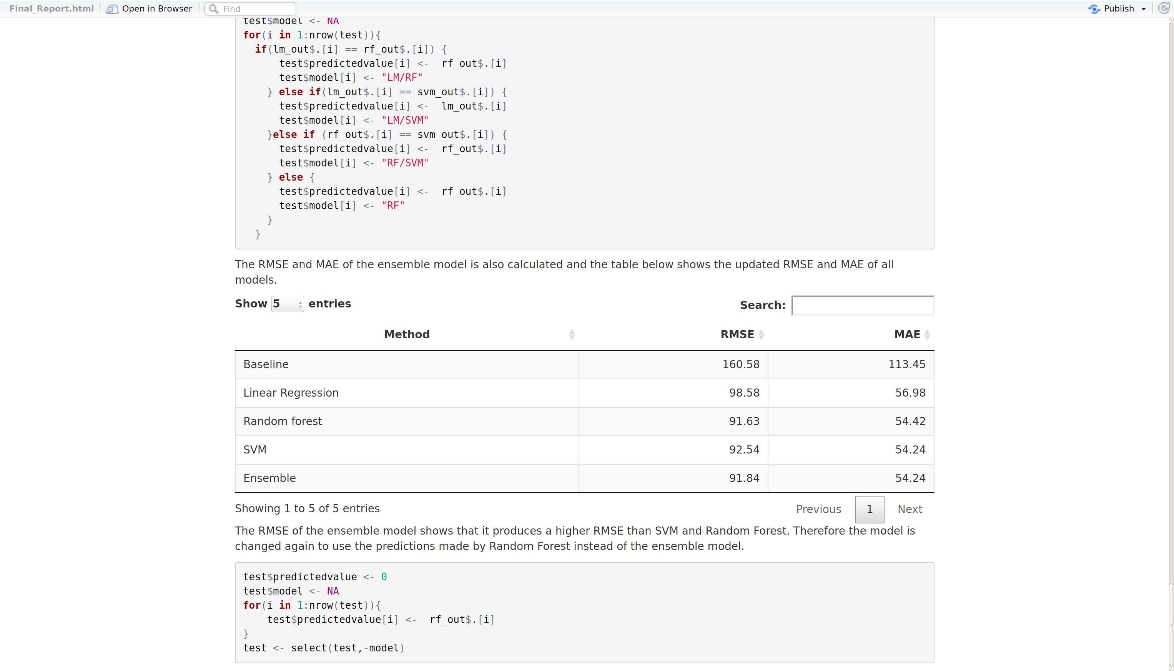
Modelling
In order to make more accurate predictions an ensemble model consisting of a Linear Regression, Linear Support Vector Machine and Random Forest was used.
Each Model was ran independently on the dataset and the accuracy was recorded.
The table below shows the accuracy of each model

Slide 9
Modelling
All the models perform better than the baseline which is the mean price. However, Random Forest predicts the listing price with lowest Root Mean Squared Error, and therefore predicts the price more accurately.
To create the ensemble model all three models are combined to create a voting algorithm where the prediction that is generated by at least two models is used.
e.g. if Linear regression and SVM predict the same price and Random forest predicts a different value, the predictions from SVM / LM is used.

Slide 10
Ensemble Modelling
The most voted price is used for the prediction, however, as Random Forest predicts with higher accuracy, it is used as the default model is none of the models predicts the same price.
The RMSE of the ensemble model is as per table below:

Slide 11
Model Evaluation & Conclusion
The ensemble model does not perform better than Random Forest as its accuracy (RMSE) is slightly lower than that of Random forest.
Therefore, we switch back to Random forest as the modelling technique used to predict the price.

